Slide 1
Discovering the Champions
2018-2019 Batch

Slide 2
Meet LTI
$1Bn
Last 12 Months
23,000+
Employees
58
Fortune 500 clients
289
Active clients
6th
Largest Indian IT services company
23
Delivery centers
globally
As of Dec 2017
©Larsen & Toubro Infotech Ltd. Privileged and Confidential

Slide 3
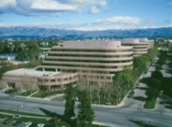
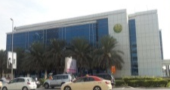
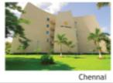
Global Footprint
Amsterdam
Belfast
Copenhagen
Espoo
Leipzig
London
Toronto
Munich
Yokohama
Oslo
Mississauga
Paris
Atlanta
Stockholm
Cincinnati
Brussels
Chicago
Toulouse
Dallas
Detroit
Kuwait
Hartford
Dammam
Bengaluru
Doha
Chennai
Houston
Dubai
Singapore
Edison
Muscat
Mumbai
San Jose
Navi Mumbai
Tampa
Pune
Costa Rica
Sales Office
Perth
Johannesburg
Melbourne
Sydney
Development/Proximity Centre
San Jose
Toronto
Hartford
Edison
Dubai
Mumbai
Pune
Chennai
Bengaluru
Notes:
The Revenue and profitability are the basic premises of any business.
In IT industry the major cost factors are the human resources.
Human resources are invested in all the projects run by the organization.
They are directly controlled by the Project Managers
More than 60% of total cost (about 58% of the revenue) is based on the project resources.

Slide 4
Basket of Offerings
Application Development, Maintenance & Support
Application Development, Maintenance, Migration & Porting,
Re-engineering, Legacy Modernization
Domain Solutions
Business process driven solutions for specific domains
Digital offerings
Cloud, IoT, Social, Smart Cities
Enterprise Resource Planning
Business Process Consulting & Re-engineering, Investment Optimization Consulting,
Design, Implementation & Roll Out, Upgrade
Maintenance & Support (SAP, Oracle, Microsoft, IFS)
Analytics & Information Management
Strategy Consulting & Roadmap Planning, Implementation & Support, Business Performance Management, Dashboards & Visualization, Advanced Analytics,
Service
Offerings
Consulting & Thought Partnership
Manufacturing Execution Systems
Apriso, Rockwell , Schneider, Siemens, GE, OSI PI, Siemens, Aspen, Solumina
Mobile Services
Enabling ERP & Reporting on Mobile Devices, Application Development, Testing, Porting and Support; User Experience Enhancement, MADP and EMM Platform Implementation’, Mobile App Factory, Front End Engineering
System Integration
Implementation, Customization, Support
Integration with third party systems
Enterprise Integration
Architecture Consulting, Business Process Modeling, Implementation , Roll Out & Support, Complex Event Processing
Infrastructure Management
24x7 Help Desk Support
Change Management
Server Monitoring
Testing & QA
Test Strategy Consulting, Automated & Manual Testing, Functional, System, Integration, Regression Testing, Specialized Testing, Content Testing

Slide 5
Package Details- Graduate Engineering Trainee (GET)
During Training Period(1st Year) – 3.18 lakhs per annum
+ Group Medical Insurance for Rs. 3,00,000/-
On Confirmation (After 1 year)- Will be revised as per industry standards and individual performance
Service Level Agreement (SLA) for a period of 2 years from the date of joining

Slide 6
Package Details- Software Application Trainee(SAT)
During Training Period(1st Year) – 3.33 lakhs per annum
+ Group Medical Insurance for Rs. 3,00,000/-
On Confirmation (After 1 year)- Will be revised as per industry standards and individual performance
Service Level Agreement (SLA) for a period of 2 years from the date of joining

Slide 7
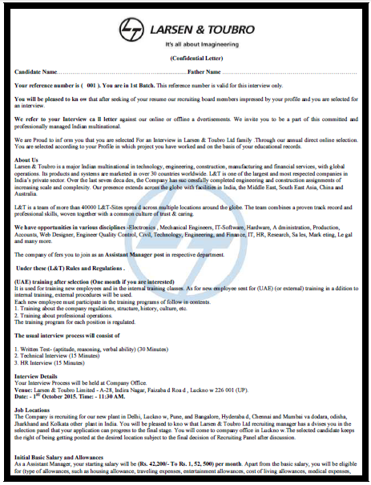
Notice on Fraudulent Job Offers
It has been brought to our attention that certain unscrupulous elements are sending out false emails purporting to be from Larsen & Toubro Infotech Limited (“L&T Infotech”). The emails ask the recipient to appear for a face-to-face interview for a job opening with L&T Infotech and to deposit a certain amount as a refundable interview security in a designated bank account. The emails are falsely stated to be from the HR Department of L&T Infotech. Please note that L&T Infotech, as a policy, does not collect any money as a pre-employment requirement. L&T and its affiliate companies bear no responsibility for amounts being deposited / withdrawn therefrom in response to such emails. These communications may carry the ID or domain name of L&T Infotech (or a deceptively similar name) to make it look authentic.
L&T Infotech is taking appropriate steps to tackle the issue. We advise candidates not to respond to any fraudulent emails and not to make any payments. In case of any doubt please contact L&T’s Toll Free No. 1800 2094545.

