Slide 1
(A unit of Prakash Retail Private Limited)

Slide 2
Where it
all began…
Prakash Electric Company began its first store at Udupi in 1987 with the Brand name “Harsha”.
To date there are 14 stores (into consumer durable retailing), 2 stores (furniture retailing), 4 large central warehouses and Corporate Office situated at Udupi

Slide 3
Harsha Highlights….
14 World class Showrooms
622 Members Strong Team
4,29,350+ Customer Database
World’s Best Brands
4 Big Annual Events
120 + Product Categories
25924 + SKUs
Rs. 412 Cr Turnover

Slide 4
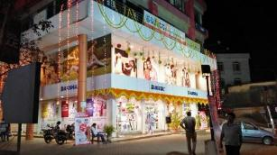
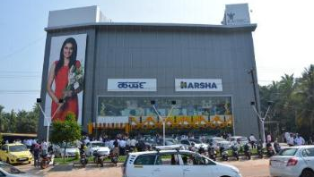
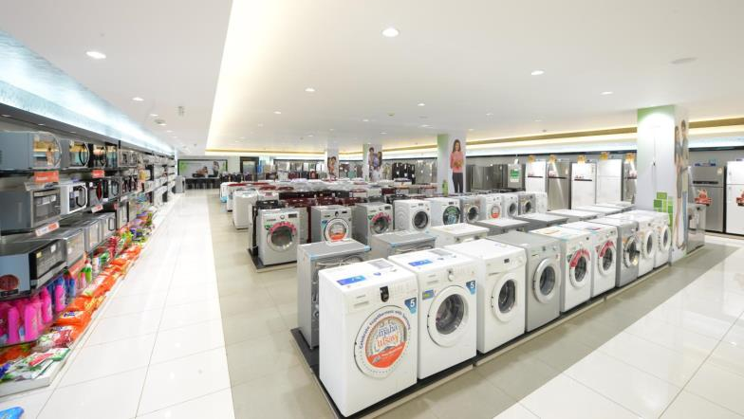
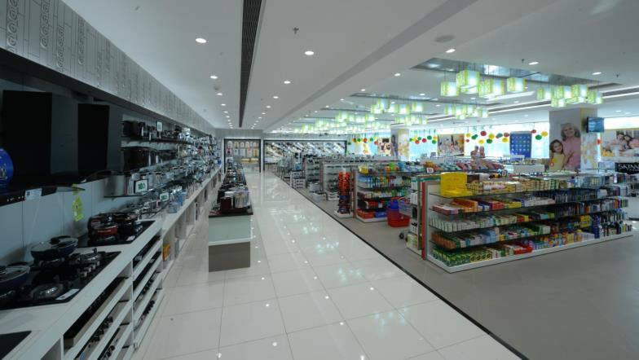
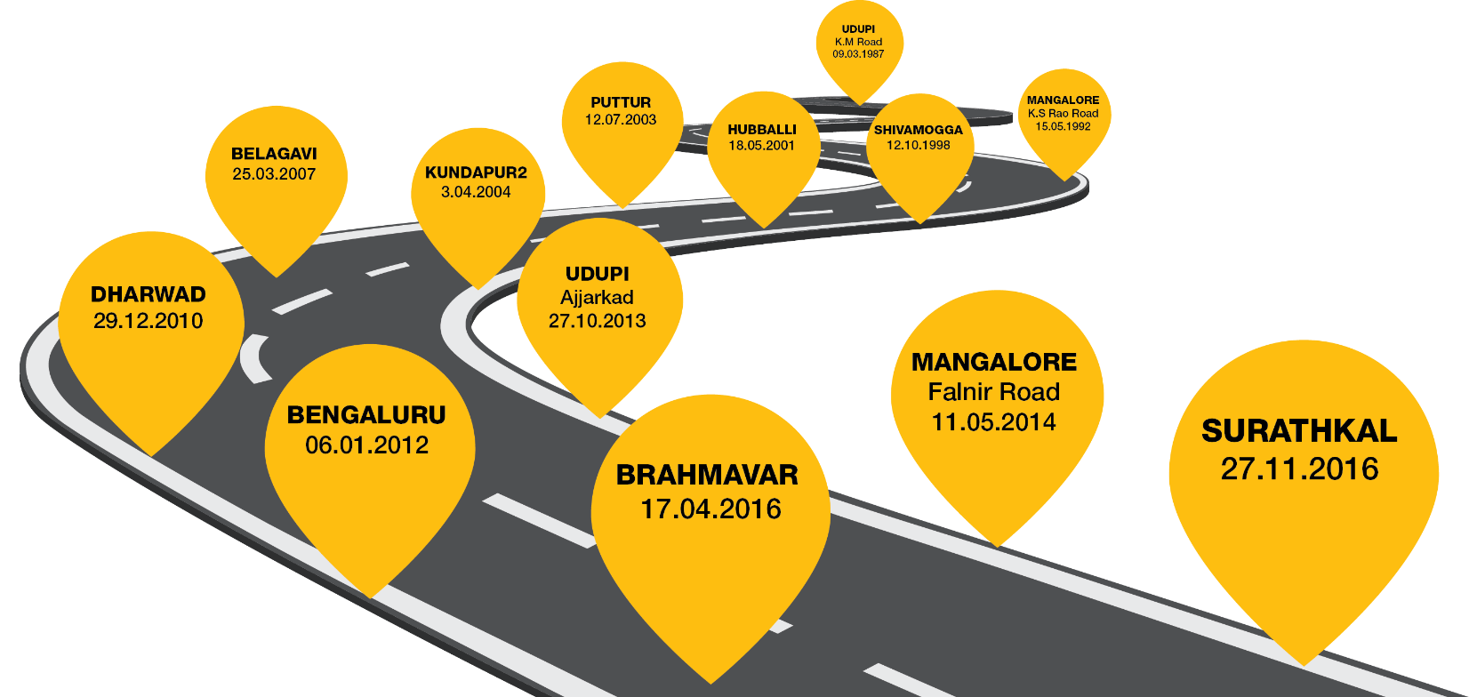
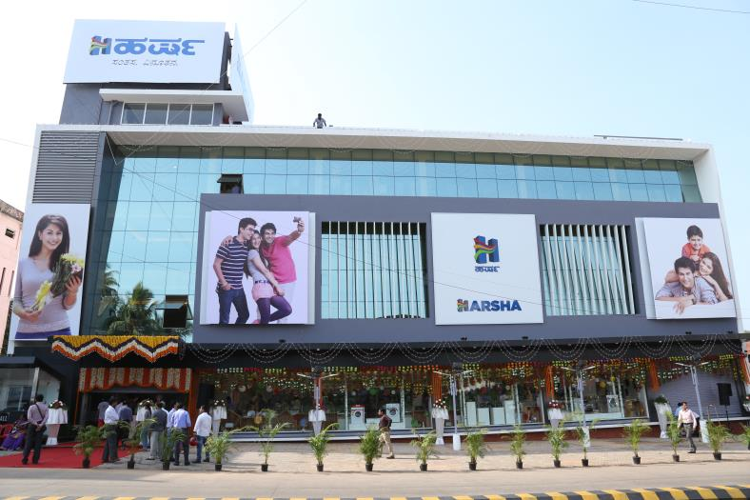
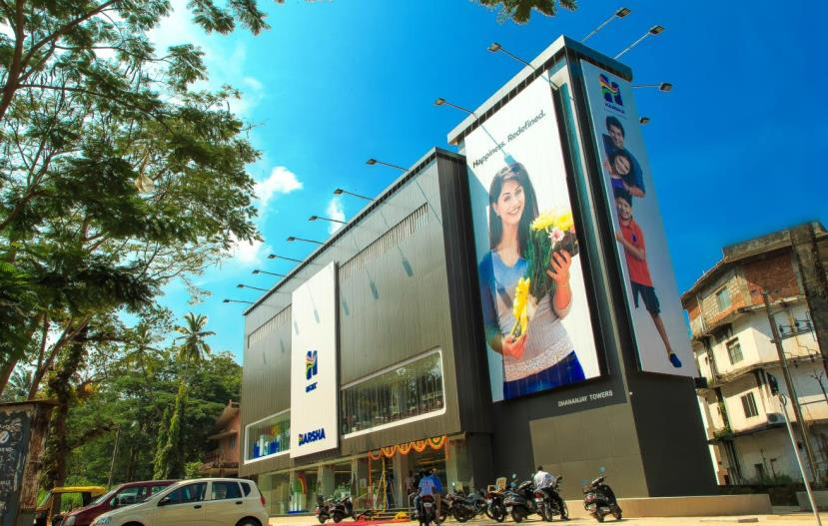
ADDING MILESTONES
14 WORLD-CLASS STORES,
LAKHS OF HAPPY CUSTOMERS
KUNDAPURA2
16-02-2019
HUBLI 2
24.08.2018

Slide 5
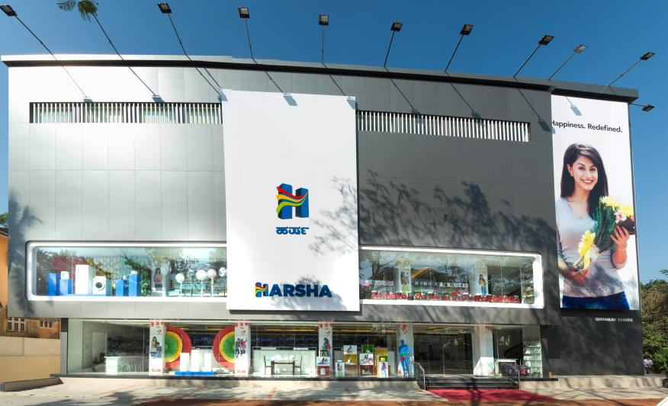

Slide 6
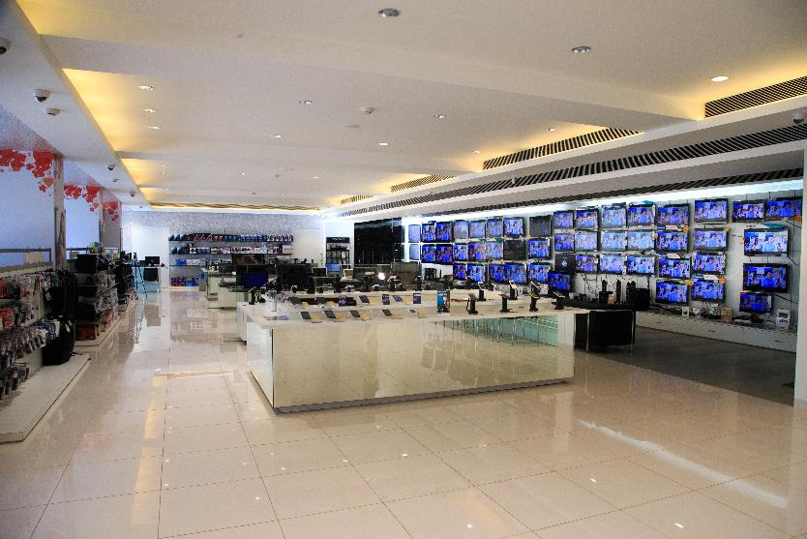

Slide 7
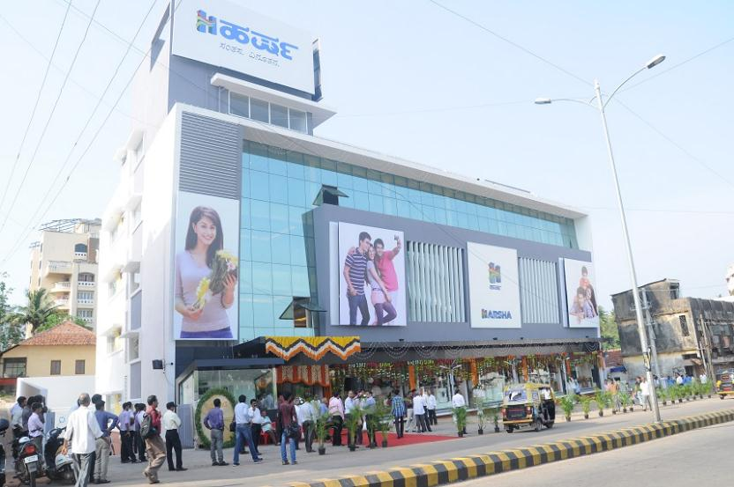

Slide 8
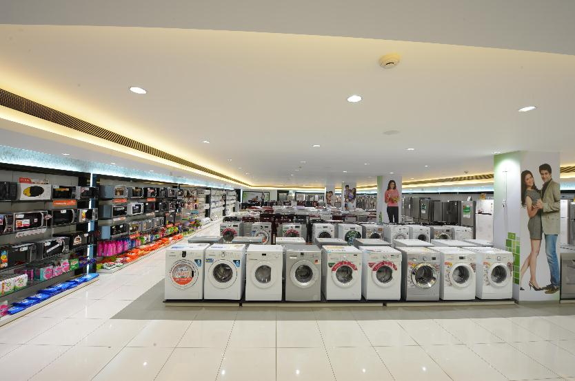

Slide 9
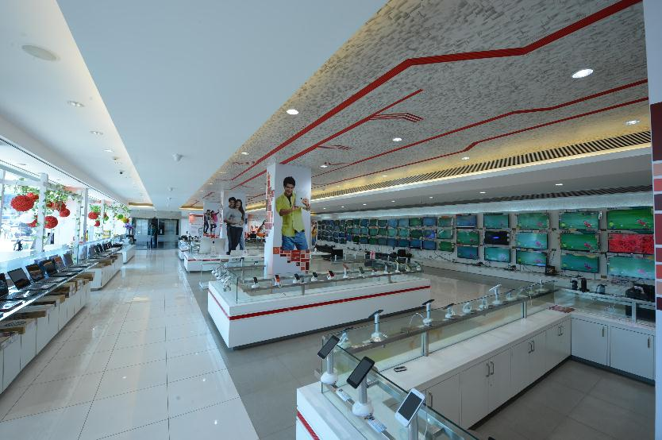

Slide 10
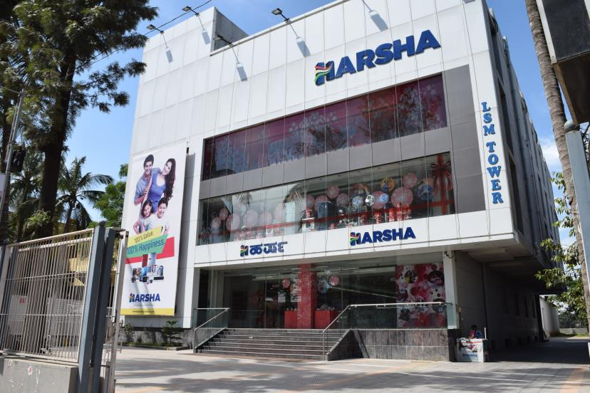

Slide 11
Brands available in Harsha

Slide 12
Composition of Workforce
Sl. | Description | Male | Female | Both
1 | GRADUATE | 217 | 106 | 364
2 | POST GRADUATE | 54 | 33 | 87
3 | DIPLOMA | 34 | 6 | 51
4 | ITI | 48 |  | 48
5 | PUC | 14 | 2 | 16
6 | SSLC | 15 |  | 23
7 | PUC ITI | 33 |  | 33
 | T O T A L | 465 | 157 | 622

Slide 13
Looking ahead….
1000 Cr turnover in topline by year 2022
11 new stores by 2022
Multistate presence
600+ retail jobs

Slide 14
Future Requirements- 2019-20
Management Trainees (MBA- Marketing, Finance, HR)- 35
Sales Associates (Graduates- BBM, Bcom, BBA, BSW, Diploma)- 100
Trainee Engineers (Engineers- BE)- 25
Merchandising Executives (BBM, Bcom)- 25
Customer Support Executives (Diploma, BE)- 20

Slide 15
Departments
Operations
Merchandising
Human Resources
Store Admin/Commercials
Customer Support
Marketing
Store Maintenance

Slide 16
Profile of Management Trainee (Sales)
Responsible for Revenue Generation and ensure achievement of floor sales target
Responsible for excellent customer service and to gain a clear understanding of customers' requirements
Responsible for discipline and adherence to Code of Conduct at the floor
Responsible for the visual appeal for the floor through effective store & stock presentation
Ensure productivity and performance targets are achieved, customer engagement and interactions are effective, Morale and Motivation of the team is upbeat and provide coaching and mentoring as required.

Slide 17
Profile of Store Commercial
Responsible for all areas relating to accounting function and financial reporting.
Ensure accuracy of revenue & expenses, execution of governmental / legal obligation and also make recommendations for enhancing profitability.
Work closely with the Store Manger and Senior Management team to support the implementation of all HR Activities and initiatives

Slide 18
Profile of Store HR
Implement various systems like Performance Management Systems, Rewards and Recognition System, Welfare Schemes or Programs, Recreational programs as per the Corporate Office HR Team guidelines.
Responsible for implementing all the training and development activities in Stores.
Guide Store associates in terms of policies, job duties, working conditions, wages, opportunities for career development, employee benefits, retention programs.

Slide 19
Profile of Customer Support Executive
Oversee day to day customer support operations in accordance with the SOP’s
Lead and Guide the efforts of the Delivery, Installation and service workforce
Improve departments productivity and performance through objective assessment of deliverable and identifying areas of improvement
Coordinate and Communicate with other departments / suppliers / stores for speedy and effective redress of customer queries / challenges
Monitor, Track, Record & Report Response time / Completion time / Progress of Complaint Resolution
Ownership and accountability for timely delivery and service
Scrutinize, Verify and Validate warranty and service contract terms and conditions

Slide 20
Compensation and Benefits
Compensation
Salary up to Rs. 3.00 lakh pa.
Performance Based Incentives
Yearly Bonus
Benefits
Learning and Development Opportunities- Retail Management Trainee Program, Selling Skills Trainings, Service Excellence Trainings, Behavioral Trainings, Leadership Training and External Workshops.
Free Food and Accommodation facilities
ESIC or Med claim facilities
Provident Fund
Traveling Allowances
Staff Uniform

Slide 21
Career Path in the Organization
Qualification: MBA
Operations Head)
PGH
Regional Manager
Cluster Manager
Manager)
Assistant Manager
Management Trainee

Slide 22
THANK YOU

